Slide 1
May 8, 2025
Transmission Studies for Ch. 324 Interconnections

Slide 2
General Updates
Clusters 03, 05 to be issued revised IAs (allocations of remaining network upgrade changed due to withdrawals)
Cluster 06 in the Detroit-Guilford Area. The analysis to determine need for network upgrade is completed. The report was sent to ISO-NE for review.
“ASO” Studies – ISO-NE Coordination
Reliability Committee (iso-ne.com)
https://www.iso-ne.com/static-assets/documents/100013/a09_03_pp_5_6.zip
ISO-NE Memo on Ongoing Order No. 2023 Compliance Proposal Implementation Activities
memo_re_order_2023_implementation.pdf (iso-ne.com)

Slide 3
New Cluster Updates
ISO-NE received a response from FERC on New England’s Orders No. 2023 and 2023-A Compliance Proposal on April 4, 2025
As a result of the ruling, the prior rules associated with serial feasibility studies and system impact studies are no longer in effect
The ISO proposes narrowly tailored Tariff revisions to only adjust transition related dates in the Compliance Proposal by approximately one year

Slide 4
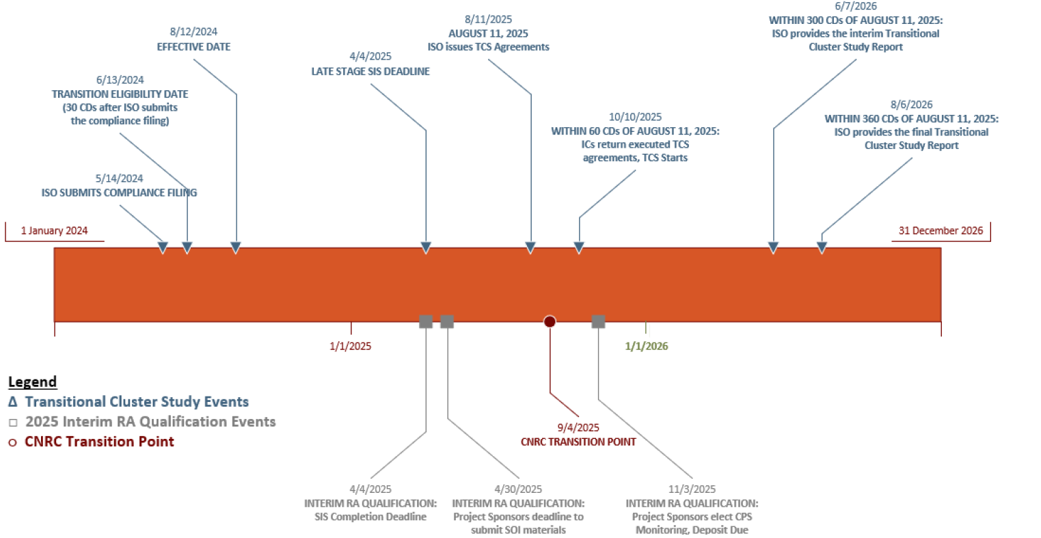
New Cluster Updates
ISO-NE’s proposed narrowly tailored date changes for Transitional Cluster Study

Slide 5
New Cluster Updates
With the ruling in place, CMP is required to respect ISO-NE’s Transitional Cluster Study process and timeline for all projects that require I.3.9. approval
The new ASO cluster study will be postponed to October 2025 and will start immediately after the start of ISO-NE’s Transitional Cluster Study (TCS). Next monthly webinars will provide details on coordination with TCS once ISO-NE releases more information on their process. In general, CMP is targeting to issue cluster study agreements and study invoices for projects to participate in CMP’s ASO Cluster Study ~1 month prior to the start of the ASO Cluster Study.
Projects under 1 MW will be included in ASO cluster study for assessment of their impact on the transmission system. CMP is continuing the discussion with MREA and CCSA on the inclusion criteria.

Slide 6
Questions

Slide 7
Appendix
The remainder of the slides are for reference. Most material has been discussed at prior webinars and remains as useful information for those who may not have attended previously or are looking for past updates not currently addressed during this month’s webinar.

Slide 8
Who to Contact with Section I.3.9 Questions?
Please email the below team should you have any questions related to the i.3.9 process.
CMP - Interconnection Services CMP-Interconnection.Services@cmpco.com
A team member will acknowledge your email and follow up internally to provide you with a timely response.
Should your project need any further assistance please contact Nate Pelletier Program Manager, Interconnection Services
Email Address: Nathan.Pelletier@cmpco.com
Also, please routinely check CMP’s public queue, at the below link/location, which is updated bi-weekly for any i.3.9 updates related to your project.
Link: Interconnection (cmpco.com)
Location of interconnections public queue

Slide 9
CMP ASO Cluster Study
Initial Plan
Two phase approach
Upfront non-refundable study fees
Study agreements for each phase
Attrition window with one-time opportunity to derate (no distribution restudy)
Align with ISO-NE Order 2023 compliance study timeline
Coordinate with the start of the ISO-NE cluster process
The TCS is not prescriptive as to study milestones: when can models be obtained from ISO-NE, when the ISO-NE mitigation be known to the affected TO, when will the ISO-NE PSCAD study begin. Anticipate process to evolve with lessons learned from TCS.
One-study window / one ASO cluster study to be performed at a time
No new cluster studies until ISO-NE’s Transitional Cluster set to begin October 11, 2024
Complete all DG/Cluster restudies for Transitional Cluster
Update
CMP is considering starting Phase 1 of a new ASO Cluster Study (steady state with PSCAD model review)

Slide 10
ISO-NE Cluster Study Coordination
CMP DG Cluster is showing today’s T&Cs
Process Timeline – Comparison to ISO-NE Cluster Study
Where do these processes align? What if there is an ISO-NE Restudy? What if there is an ISO-NE Facilities Study? What if there is none or both?
Cluster Window Closed
Customer Kick-off Meeting
Cluster Study Phase 1
Results Meeting Issue Phase 2 Agreements Attrition / Derate Window
Execute IA / Invoice Upgrades
Results Meeting / RC / I39 Approval / IA
Cluster Study Phase 2
Execute Agreements
^{Issue Phase 1 Report}
DG Cluster
61 Weeks
BD
15
10
5
140
5
10
100
20
Wk
3
2
1
28
1
2
20
4
ISO-NE
Cluster Request Window
Customer Engagement Window
Cluster Study
Cluster Study Report Meeting & IC CRD Submittal
Interconnection Agreement
72 Weeks
CD
45
60
270
40
75
Wk
6.4
8.6
38.6
5.7
10.7

Slide 11
ISO-NE Cluster Study Coordination
Process Timeline – Comparison to ISO-NE Cluster Study
Where do these processes align? What if there is an ISO-NE Restudy? What if there is an ISO-NE Facilities Study? What if there is none or both?
Review timeframe required
Review timeframe required
Cluster Window Closed
Customer Kick-off Meeting
Cluster Study Phase 1
Results Meeting Issue Phase 2 Agreements Attrition / Derate Window
Execute IA / Invoice Upgrades
Results Meeting / RC / I39 Approval / IA
Cluster Study Phase 2
Execute Agreements
^{Issue Phase 1 Report}
DG Cluster
67 Weeks
BD
15
10
5
5
10
20
Wk
3
2
1
20
1
2
34
4
ISO-NE
Cluster Request Window
Customer Engagement Window
Cluster Study
Cluster Study Report Meeting & IC CRD Submittal
Interconnection Agreement
72 Weeks
CD
45
60
270
40
75
Wk
6.4
8.6
38.6
5.7
10.7
When will the next ISONE Cluster kick-off?

Slide 12
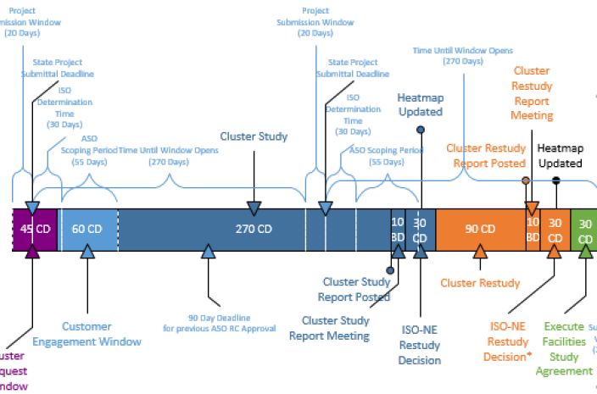
ISO-NE Cluster Study Coordination
Cluster Window Closed
Customer Kick-off Meeting
Cluster Study Phase 1
Results Meeting Issue Phase 2 Agreements Attrition / Derate Window
Execute IA / Invoice Upgrades
Results Meeting / RC / I39 Approval / IA
Cluster Study Phase 2
Execute Agreements
^{Issue Phase 1 Report}
DG Cluster
67 Weeks
BD
15
10
5
5
10
20
Wk
3
2
1
20
1
2
34
4
10/10/2024 CMP Cluster Study kick-off
9/16/2024
Anticipate ISONE determinations
3/6/2025 Issue Report Phase 2 Agreement & Invoice
11/14/2025 – 1/6/2026 Approvals and Issue IAs
9/23/2024
Issue CMP cluster study agreements & study invoices
10/6/2025 – 11/20/2025 ISONE Initial Cluster Request Window
10/10/2024 – 2/27/2025 140d for Phase 1, including ASO scoping with ISONE & PSCAD model testing
3/6/2025 - 3/20/2025 Execute Phase 2 Agreement
3/21/2025 – 11/14/2025 238d for Phase 2
8/30/2024 CMP submits Level 4 projects for ISONE determination
10/11/2024 Deadline for CMP ASO models for studies wrapping up

Slide 13
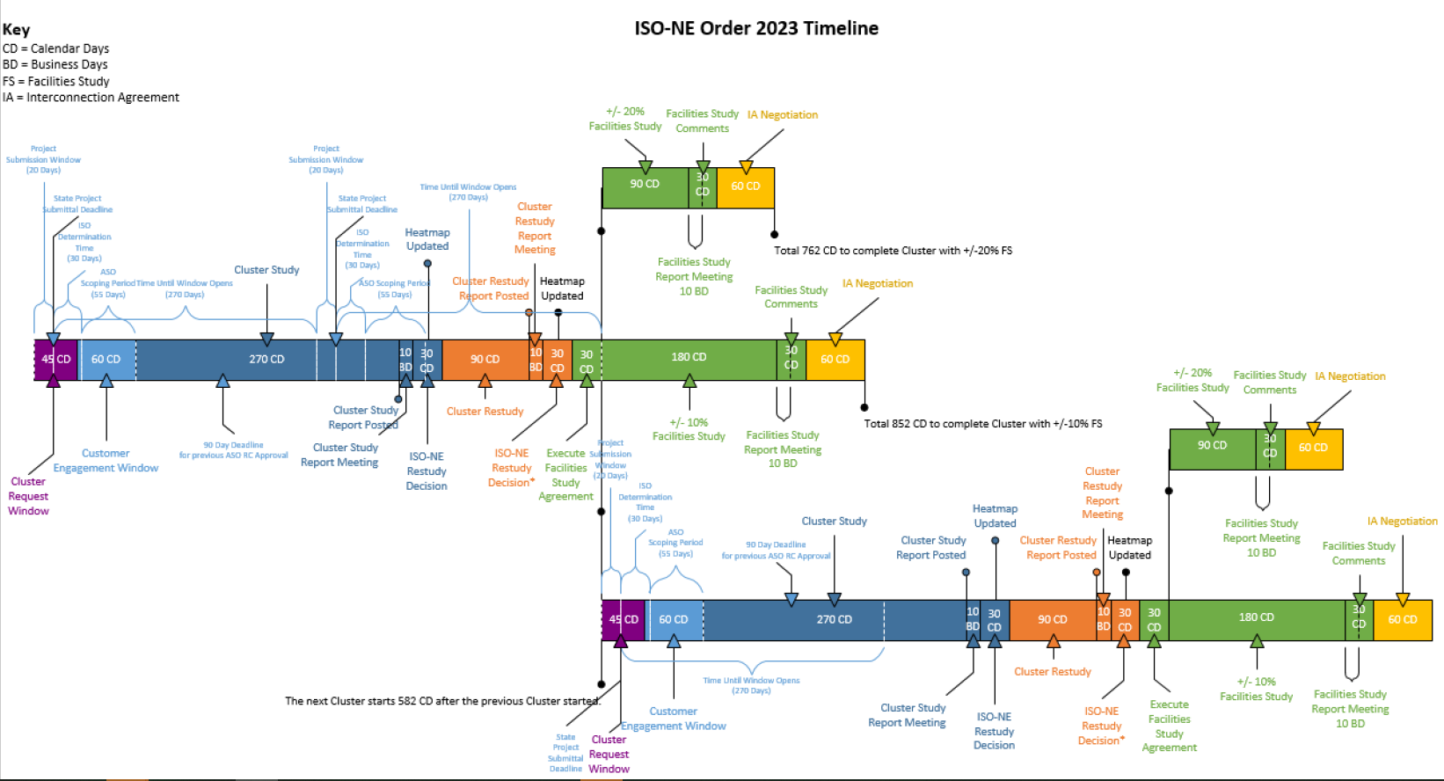
ISO-NE Cluster Study Coordination

Slide 14
Level 3 Aggregate Study Milestone Details
High-Level Cluster Milestone | Milestone Detail
Data Gathering & Model Build | Project Specific Data Gathering
 | Data Review & Identify Deficiencies
 | Address Issues
 | Review D-ckt Data
 | Address D-ckt Issues
 | Model Updates
 | Complete Data Reviews & Update Models
Scope Development | Study SOW Planned
 | Study SOW Plan Discussed with ISO-NE
 | ISO Review & Comment
 | Create Detailed Scope with Base Cases
 | SOW Reviewed & Comments Provided by ISO-NE
 | Model Updates
Steady State & Short Circuit Needs Identified | Analyses
 | Results Review
Mitigation Identified & Analysis Complete | Mitigation Proposed & Evaluated
 | Final Recommendations
 | Cost Allocation
PSCAD | PSCAD
Report Development & Reliability Committee Approval | Report Development
 | Incorporate PSCAD
 | Report Reviewed & Comments Provided by ISO-NE
 | ISO-NE Comments Addressed
 | Results Check-in
 | PPAs Prepared
 | Reliability Committee & I39 Approval
Results Check-in

Slide 15
Process Improvements – Filed September 1, 2021
Proposed Process
Milestones and Financial Commitments
Phase 1
Steady State Analysis (SSA),
Stability
Phase 2
Adjust SSA, Stability
PSCAD Analysis
Phase 2
I.3.9 Submittal
Post I.3.9 Approval
Study true-up with remaining projects
Projects with I.3.9 approval are invoiced.
Restudy if required based on attrition
Phase 1 Begins
Cluster Study Agreement
Non-refundable Study Fee
Phase 2 Begins
Non-refundable Study Fee

Slide 16
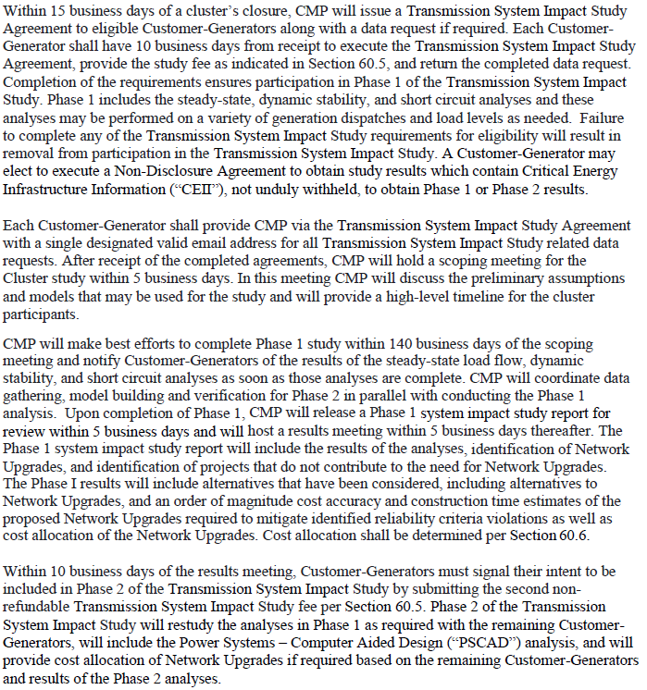
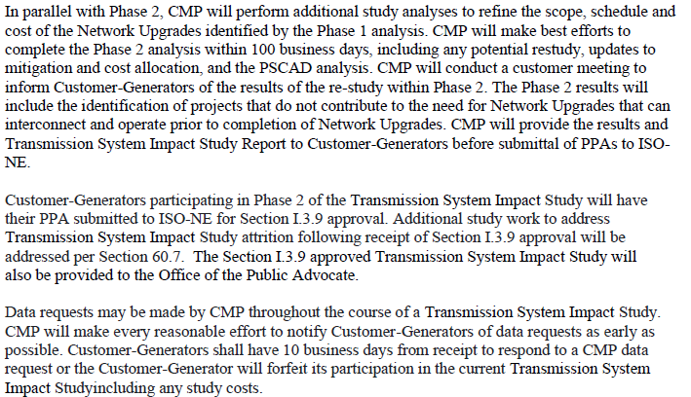
Terms & Conditions – Docket No. 2021-00277**
Phase 1 & Attrition Window
Phase 2 & Data Requests
**T&Cs are being reviewed and updated to reflect the changes to the cluser study process

Slide 17
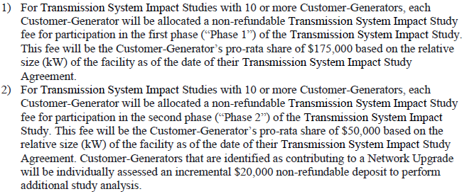
Terms & Conditions – Docket No. 2021-00277**
≥ 10 PRJs Study Fees/Costs
< 10 PRJs Study Fees/Costs
Study Invoicing
**T&Cs are being reviewed and updated to reflect the changes to the cluser study process
T

Slide 18
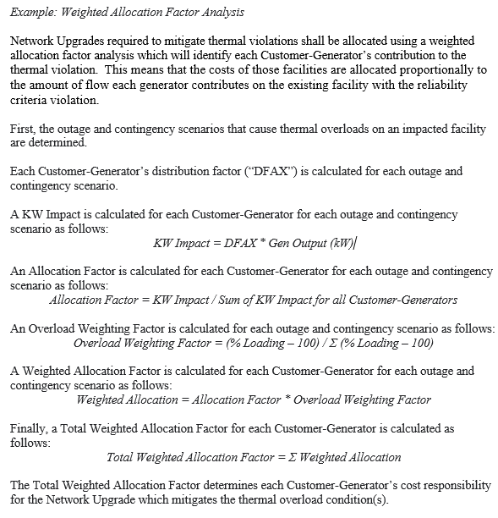
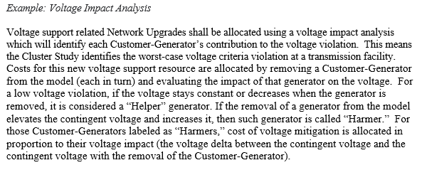
Terms & Conditions – Cost Allocation**
**T&Cs are being reviewed and updated to reflect the changes to the cluser study process

Slide 19
Conceptual Engineering Study – T&Cs
The level of improved cost & time estimates will be dependent on the amount of network upgrades and the amount of contributing DG
Substations
Lines
Site visit to the existing site and potentially to the remote ends
Complete surveys needed to develop the scope of work, depending on the project
Topographical Survey
Earthwork Quantities Report
Geotechnical Survey
Improve scope definition by the performance or generation of some or all of the following:
Permitting, Real State and Outreach needs assessment
Storm Water Pollution Prevention Plan (SWPPP)
Site Plan (Install & Removal)
General Arrangement (Install & Removal)
Engineering notes
Preliminary bill of materials
Post fault current study - Aspen model
Fault Duty Analysis
CT Performance Calculations
Power One Line Diagram
Relay One Line (existing site and remote ends)
Integration One Line (existing site and remote ends)
Communication One Line (existing site and remote ends)
Ampacity Analysis of Underground Cables (When applicable)
Construction Sequence
Outage Sequence
Develop a Conceptual Design Package by doing the following:
Gathering LiDAR topographic survey
Developing a design criteria document to summarize:
Project scope of work
Type of transmission structures, conductor and shield wire to be used
Compile electrical and structural standards to be used on the project
Creating a PLS-CADD model of the transmission line work
Developing a preliminary materials list and construction bid form
Refine permitting and real estate scope

Slide 20
T&Cs: Schedule Comparison – With Attrition Window
Per developers’ request, proposed T&Cs enable developers to consider attrition before completion of the study
Inherently results in schedule extension following conclusion of Phase 1 (Pre-PSCAD Assessment)
1 month: No attrition (hold period for developer consideration)
4-5 months: Attrition

Slide 21
T&Cs: Milestone Summary
 | Phase I |  |  |  |  |  | Phase II
 | Challenge Work* |  | Results Check-In* |  | Attrition Window* |  | Re-Study Cost Allocation* |  | I.3.9 Approval*
Milestone | Previous Schedule | T&C Option #2 Implemented | Previous Schedule | T&C Option #2 Implemented | Previous Schedule | T&C Option #2 Implemented | Previous Schedule | T&C Option #2 Implemented | Previous Schedule | T&C Option #2 Implemented
Clusters 07, 08 & 10 | 22-Jun | 22-Jun | 22-Sep | 22-Sep |  | 22-Oct |  | 23-Jan | 22-Nov | 23-Apr
Cluster 09 | 22-Jun | 22-Jun | 22-Sep | 22-Sep |  | 22-Oct |  | 23-Jan | 23-Jan | 23-Mar
Clusters 11 & 12 | 22-Jul | 22-Jul | 22-Sep | 22-Sep |  | 22-Oct |  | 23-Jan | 22-Nov | 23-Apr
Cluster 13 | 22-Nov | 23-Jan | 22-Dec | 23-Apr |  | 23-May |  | 23-Aug | 23-Apr | 23-Jun
Clusters 14 & 15 | 22-Aug | 22-Aug | 22-Oct | 22-Oct |  | 22-Nov |  | 23-Feb | 22-Nov | 23-May
Cluster 16 | 22-Jul | Complete | 22-Sep | 22-Aug |  | 22-Aug |  | 22-Sep | 22-Nov | 22-Nov
Will not transition these to T&Cs with exception of Cluster 13
*Dates shown are estimated completion dates
*Schedule includes re-study periods that could be reduced in a best-case scenario

Slide 22
PSCAD General Update
Recent studies have shown that certain inverter technologies are vulnerable to tripping following bulk system events such as faults. The primary mechanism for tripping is an instantaneous overvoltage protection which is designed to disconnect the inverters when any individual phase exceeds some threshold (eg. 1.25-1.4 pu depending on inverter and manufacturer). This protection may exist to protect the inverter hardware, or (more likely) may exist to prevent the inverter from causing a voltage to exceed IEEE 1547 TOV standards in the case of a load rejection or island event. Transient voltages exceeding these levels are not frequent in the bulk grid, but are possible during extreme fault events, and bulk grid devices (not subject to IEEE 1547 standards) are typically able to withstand them.
This problem is made worse by the nature of the fault conditions being analyzed. In particular, several critical events leave significant portions of DER connected to the grid very weakly through the distribution system. These weak conditions can result in the inverters being unable to maintain tight control over their currents during and immediately following severe faults, and in some cases they may inject enough current following the fault to create a voltage transient high enough to trip themselves off.
It is possible in theory that the equipment protection may be relaxed to ride through higher voltages, although that would be subject to actual hardware limitations, and may also cause the plants to be unable to meet IEEE 1547 or regional requirements for islanding. It is also possible that the inverter controls could be tuned to provide better control over local current injections and avoid creating the over-voltages that result in tripping.
Inverter manufacturers/types that CMP has confirmed are vulnerable to this issue based on the results of the Sanford/Quaker Hill Cluster 04 study include: Sungrow SG125HV, SMA STP Core1 62-US, SMA SHP Peak 3 125-US or 150-US.

Slide 23
Winslow-Lakewood Cluster 02
Curtailment Solution Summary
The Winslow-Lakewood transmission system impact study identified N-1 and N-1-1 thermal overloads on the 34.5 kV which require mitigation.
N-1
The study identified a need to upgrade a single 34.5 kV line to address a N-1 thermal overload. The Network Upgrade would be cost allocated to four (4) projects in the Winslow area.
N-1-1
In order to address multiple N-1-1 thermal overloads, CMP developed two solution alternatives. The first alternative consisted of the upgrade/rebuild of approximately 42 miles of 34.5 kV transmission lines, estimated to cost $98.8M and allocated among 18 of the 20 cluster projects. Another alternative considered was a locally implemented DER Curtailment Solution that would prohibit the DERs from participating in the ISO New England markets. This curtailment solution would require local CMP operator action to curtail the DER within the Winslow and Lakewood Cluster to avoid potential thermal overloads for a subsequent contingency event. This curtailment solution was approved by the ISO-NE and was narrowly tailored for subtransmission contingencies that resulted in constraints on the subtransmission system. Due to the manual nature of this curtailment solution, CMP will evaluate the scalability of implementing similar solutions in other areas on a case-by-case basis.
While the projects have saved significant time and upfront expense, the restriction that prevents the projects from being registered in ISO-NE Markets remains a financial concern to developers. CMP has been working with the ISO to identify and work towards a path to permit the Market registration (registration as settlement-only) for these impacted generators, where the contingency and the overloaded element are not on pool-transmission facilities (PTF). The ISO-NE will be bringing its proposal to this month’s NEPOOL Reliability Committee for stakeholder discussion.
Projects in Cluster 02 received revised IAs around February 14th and will be required to meet project milestones such as making payments between now and resolution of ISO Market Registration

Slide 24
Cluster 02 - Winslow-County Rd-Lakewood -1
Cluster 02 Winslow-Lakewood Final report and PPAs were submitted to ISO-NE on November 30th
RC meeting held December 14th, 2021 and received recommendation for approval
The recommendation includes a locally implemented DER Curtailment Solution with the DERs being managed and dispatched locally instead of participating in the ISO New England markets
Received ISO-NE I.3.9 approval on 12/17. This cluster is now considered complete.
LINK to Biweekly Report

Slide 25
Other Transmission Items
CMP has revised its model requirements and source requirements documentation and is expecting all projects to follow the latest revision which can be found on the CMP website.
Power Factor Adjustments
If the Impact Study report calls for 99% power factor and the requirement to absorb VARs, even though the inverter may be capable of outputting the maximum requested MW while absorbing the requested VARS, the distribution analysis intended that the MWs would be reduced and the i.3.9 reflects this intended MW restriction.

Slide 26
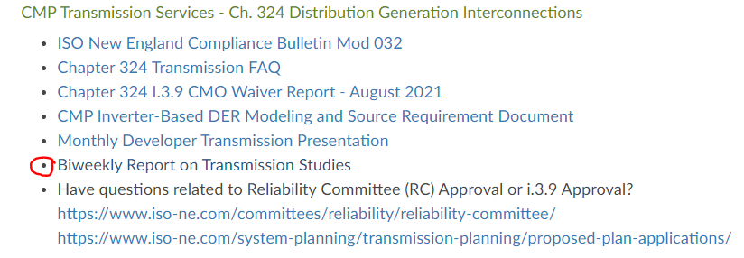
General Information – Biweekly Reports
CMP is posting reports biweekly every other Friday beginning October 8 containing individual cluster study schedules.
Biweekly Reports provide non-CEII details on the clusters, the cluster schedules, cluster dependencies, and preexisting conditions.
Posting of the detailed Biweekly Report permits this presentation to focus on the highlights of each cluster.

Slide 27
General Information – CEII NDAs
CMP is providing Critical Energy Infrastructure Information (CEII) non-disclosure agreements (NDA) to cluster participants.
CEII results will be provided at five milestones throughout the cluster study process.
Preliminary steady-state study results prior to mitigation. These will be shared to provide an order of magnitude view of the potential network upgrades necessary.
Phase 1 study results at the conclusion of the Phase 1 study, which will include mitigation and cost allocations associated with steady-state, short circuit and stability analyses
Restudy results inclusive of revised cost allocations
PSCAD results if any adverse conditions have been identified
Final reports at the conclusion of Phase 2

Slide 28
Transmission Study Requirement
CMP is required to ensure the reliability of the transmission system
CMP performs a transmission assessment on all Level 4 interconnection requests, regardless of size
I.3.9 review is a separate review process (ISO-NE PP5-1)
Applies to all projects greater than 1 MW and some projects less than 1 MW if included in an aggregate study
ISO-NE is the final authority on what transmission study is required to receive the necessary i.3.9 approval
Projects with completed studies are presented at the NEPOOL Reliability Committee (RC)
Meets on a monthly basis; recommends approval or disapproval to ISO-NE
Process culminates in ISO-NE I.3.9 approval letter
Permission to commercially operate with CMP will not be authorized until the project has received ISO-NE approval letter
The i.3.9 process is independent of the Ch. 324 process. CMP sees each project to IA completion in accordance with the Ch. 324 timelines

Slide 29
Level 0 with Non-Comprehensive Study
Study Threshold
< 5 MW individually and
≥ 5 MW and < 20 MW of DG in aggregate at 115 kV substation or electrically close 115 kV substations
Study Scope
Steady state only
Evaluated at Peak and Shoulder or Light Load with heavy N-S Transfers
Report submitted to ISO-NE
If no criteria violations, proceed to ISO notification form, PP-1 Attachment 3
If criteria violations, project responsible for network upgrades
Typically on RC Consent Agenda
Study Cost Estimate
$3,000 - $10,000

Slide 30
Non-Comprehensive Study Update
Due to large amount of DG already approved to interconnect through the ISO-NE I.3.9 process, projects with non-comprehensive designations are under evaluation at the ISO-NE to determine if they still can obtain their approval through the use of the ISO-NE Level 0 notification form (with a NC study) or if they will require the full Level III analysis.
If the ISO-NE determines that the areas where these projects will interconnect is saturated (exceeds the 20 MW threshold), CMP will attempt to roll these into existing cluster studies where feasible.
All new projects > 1 MW proposing to interconnect that have not been given a prior NC designation can expect to require an ISO-NE Level III study.

Slide 31
Level 3 (III)
Study Threshold
≥ 5 MW individually
Study Scope
Steady state, short-circuit, stability
Evaluated at variety of load levels and dispatches per ISO-NE recommendation
If criteria violations, project responsible for network upgrades
Report submitted to ISO-NE
Requires ISO form, PP-1 Attachment 1
Results presented at RC
Study Cost Estimate
Approx. $20,000 - $65,000 Approx. $25,000 - $35,000 adder for PSCAD
These Individual Level III projects must submit PSSE load flow and stability models for their projects that are specifically tailored to their project’s characteristics. Standard library models are required. In addition, a project-specific short circuit model for use with ASPEN and a project-specific PSCAD model are required.

Slide 32
Level 3 (cont’d)
Evaluate effect of proposed generation interconnections on the steady-state, stability, and short-circuit performance of the Pool Transmission Facilities (PTF) in central Maine. Develop system models to simulate the proposed interconnections under various operating conditions to evaluate if the interconnections have a Significant Adverse Impact on steady-state, stability, or short-circuit performance in accordance with ISO-NE Planning Procedures 5-3 and 5-6.
Definition of Significant Adverse Impact from the ISO-NE Technical Planning Guide Section 5 - Appendices:
A change to the transmission system that increases the flow in an Element by at least two percent (2%) of the Element’s rating and that causes that flow to exceed that Element’s appropriate thermal rating by more than two percent (2%). The appropriate thermal rating is the normal rating with all lines in service and the long time emergency or short time emergency rating after a contingency.
A change to the transmission system that causes at least a one percent (1%) change in a voltage and causes a voltage level that is higher or lower than the appropriate rating by more than one percent.
A change to the transmission system that causes at least a one percent (1%) change in the short circuit current experienced by an Element and that causes a short circuit stress that is higher than an Element’s interrupting or withstand capability.
With due regard for the maximum operating capability of the affected systems, one or more of the following conditions arising from faults or disturbances, shall be deemed as having significant adverse impact: A fault or a disturbance that cause:
Any loss of synchronism or tripping of a generator
Unacceptable system dynamic response as described in PP 3
Unacceptable equipment tripping: tripping of an un-faulted bulk power system element (element that has already been classified as Bulk Power System) under planned system configuration due to operation of a protection system in response to a stable power swing or operation of a Type I or Type II Special Protection System in response to a condition for which its operation is not required

Slide 33
Level 3 Aggregate Studies
Study Threshold
≥ 20 MW of DG in aggregate at 115 kV substation or electrically close 115 kV substations
Project Inclusion
Must have an executed study agreement prior to cluster kick-off
Study Cost Estimate
Approximately $500,000 for a cluster of 20 projects
Study costs allocated on a per MW (under study) basis
Midday Minimum scenarios could add up to $38k per cluster regardless of size
Restudies including QP additions/withdraws and PRJ addition/withdraws/reductions due to leapfrogging and complex mitigation all impact the timelines and study costs

Slide 34
Level 3 Aggregate Studies (cont’d)
Steady State Dispatch (Representative only)
Peak Load D1 dispatch:
New Brunswick exporting 1050 MW to New England
Heavy north to south transfers across Maine and Northern New England
QP639 offline
Peak Load D2 dispatch:
New Brunswick exporting 1050 MW to New England
Heavy north to south transfers across Maine and Northern New England
QP 639 online
Peak Load D3 dispatch:
New England exporting 550 MW to New Brunswick
South to north transfers across Maine
Shoulder Load D4 dispatch:
New Brunswick exporting 1050 MW to New England
Surowiec South Transfers Reduced
Heavy Southern Maine Generation
Light Load D5 dispatch:
New Brunswick exporting 1050 MW to New England
Heavy north to south transfers across Maine and Northern New England
Minimum Load D6 dispatch:
New Brunswick - New England, Orrington-South, Surowiec-South and ME-NH interface transfers all < 100 MW
No large synchronous generators on in Maine and New Hampshire
QP639 offline

Slide 35
Level 3 Aggregate Studies (cont’d)
Modeling
2019 or 2020 ISO-NE Model Administration and Support (MAS) Cases
Study year 2021 or 2022
Include relevant ISO “QP” Projects
Short Circuit
ASPEN short-circuit analysis of all PTF circuit breakers in the vicinity of this interconnection. The case for the short circuit study will originate from the ISO-NE short circuit case library.
Stability
Test the dynamic response of the proposed generators’ PSSE models in accordance with ISO-NE’s Generator Testing Procedure including testing the dynamic response of the power system for design contingencies near the interconnection. The case for the short circuit study will originate from the ISO-NE short circuit case library.
< 5 MW aggregate on distribution buses using DER_A with NERC parameters adjusting ride-thru to ISO SRD requirements

Slide 36
Level 3 Aggregate Studies (cont’d)
PSCAD
ISO-NE requires PSCAD studies for clusters over 20 MW
Send in the PSCAD files to the CMP Interconnections Team (CMP-Interconnection.Services@cmpco.com)
Identify the Project Number associated with each submittal
If one company is using the same inverters for all of its projects, submit multiple files
Follow the ISO-NE Source Requirements Document (SRD). At this time, CMP does not have our own SRD. The models would be what you submit to Eversource as opposed to National Grid.
Include documentation – CMP Transmission Planning does not have the internal capability of verifying the PSCAD submittals.
We can expedite review by using documentation to confirm the minimum requirements (consistent with ISO SRD).
Ensure the files are for the right inverter (ie SC2000 vs SC2500) and for the correct frequency (60 Hz)
Send in models for If a project has a plant controller, this should be included in the model.
Additional Resource:
https://www.electranix.com/pscad-model-requirements/
Latest edition: PSCAD Model Requirements Rev. 10, February 3, 2021

Slide 37
Level 3 Aggregate Studies (cont’d)
Cluster Study – Mitigation Challenge Session
Proposal to implement project-focused challenge session internal to the cluster study process is being implemented in the Winslow-Lakewood cluster study
Specifically designated cluster study engineers will perform review of results and propose alternative mitigation strategies if available for consideration
No study models, contingency files, etc. will be shared with individual Projects or developers or their engineering firms
Challenge session alternatives will be included in the final CEII report

Slide 38
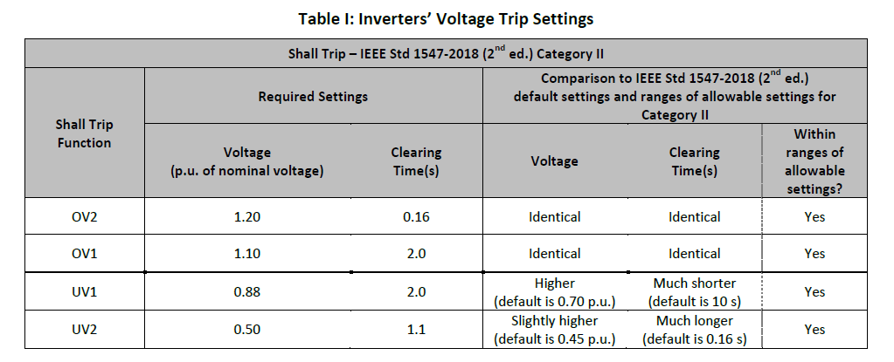
Level 3 Aggregate Studies (cont’d)
Protective Trip Settings
Many projects’ protective trip settings are not compliant with the ISO-NE’s Inverter Source Requirement Document (SRD)
https://www.iso-ne.com/static-assets/documents/2018/02/a2_implementation_of_revised_ieee_standard_1547_iso_source_document.pdf

Slide 39
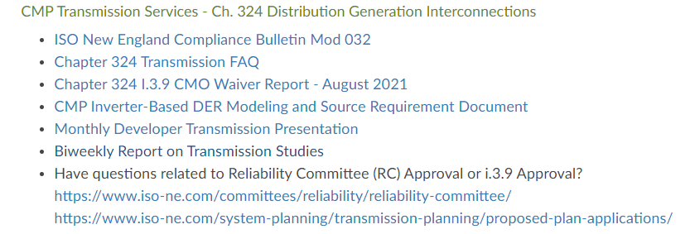
Important Links
CMP Interconnections Webpage: Interconnection (cmpco.com)

Slide 40
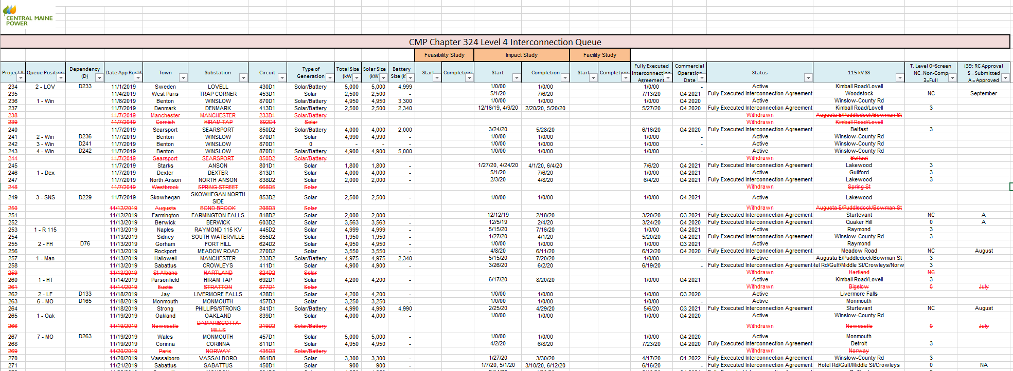
Important Links (cont’d)
Central Maine Power MPUC Chapter 324 Interconnection Project List

Slide 41
Important Links (cont’d)
ISO-NE
https://www.iso-ne.com/participate/applications-status-changes/interconnection-process-guide/is-the-interconnection-process-right-for-you
https://www.iso-ne.com/system-planning/transmission-planning/proposed-plan-applications/
https://www.iso-ne.com/static-assets/documents/rules_proceds/isone_plan/pp05_1/pp5_1.pdf
https://www.iso-ne.com/static-assets/documents/rules_proceds/isone_plan/pp05_3/pp5_3_final.pdf
https://www.iso-ne.com/static-assets/documents/rules_proceds/isone_plan/pp05_6/pp5_6.pdf
https://www.iso-ne.com/static-assets/documents/2017/03/transmission_planning_techincal_guide_rev6.pdf
ISO-NE’s Inverter Source Requirement Document (SRD)
https://www.iso-ne.com/static-assets/documents/2018/02/a2_implementation_of_revised_ieee_standard_1547_iso_source_document.pdf

